Slide 1
Data Link Control Protocols Chapter 7

Slide 2
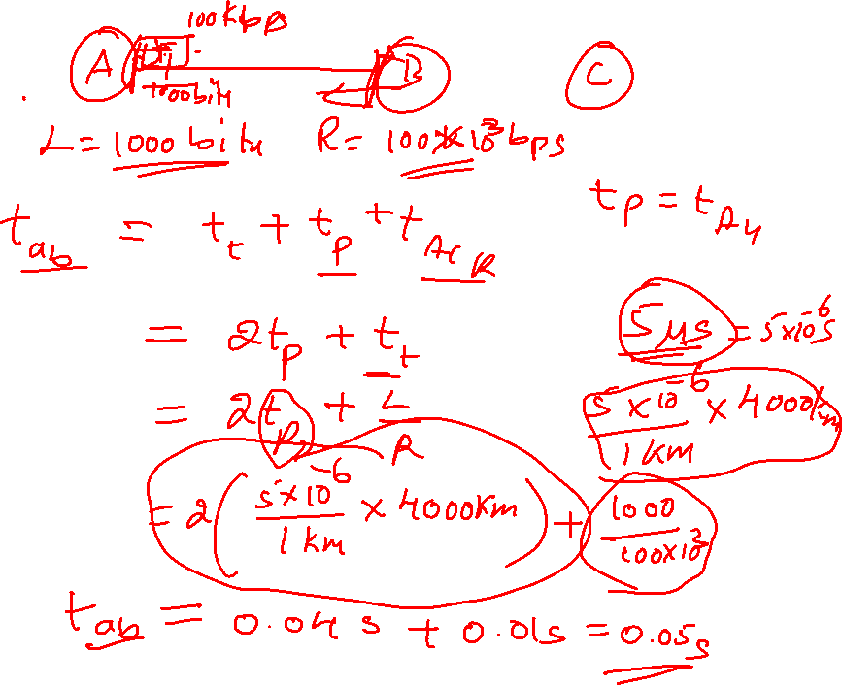


Slide 3
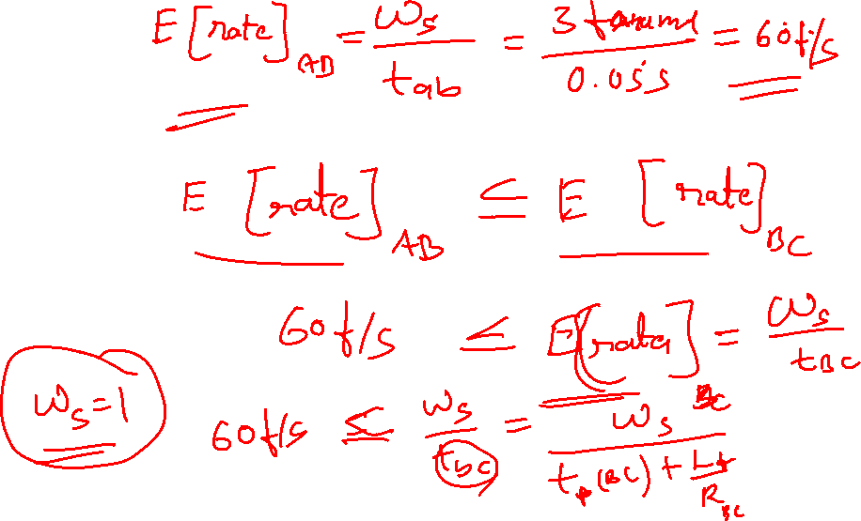

Slide 4
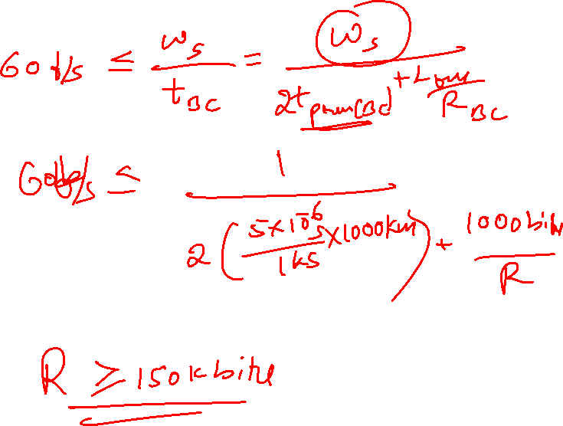

Slide 5
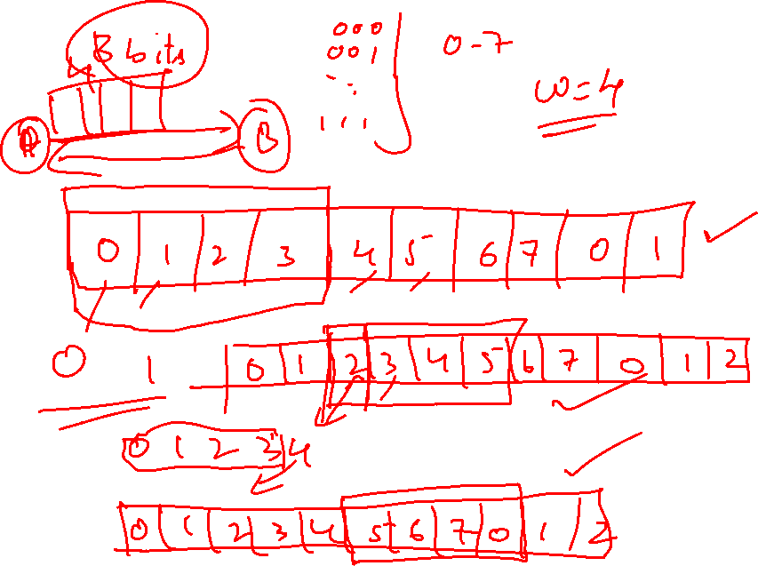

Slide 6
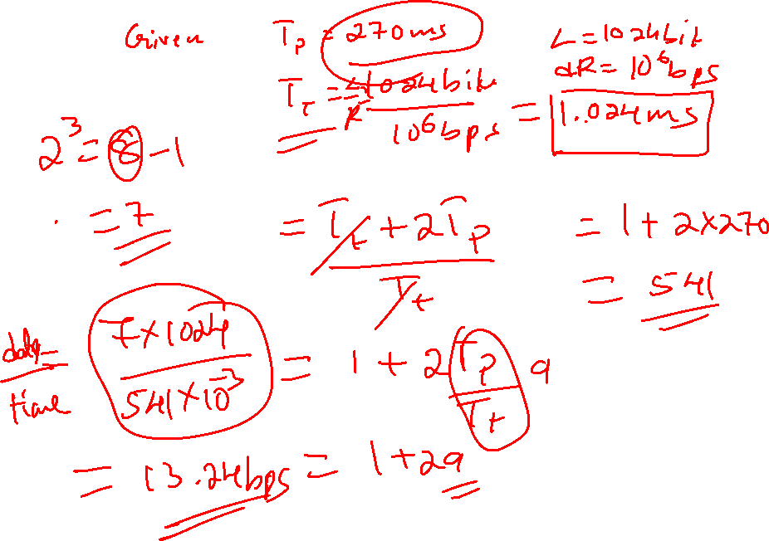

Slide 8
Data Link Control Protocols
need layer of logic above Physical
to manage exchange of data over a link
frame synchronization
flow control
error control
addressing
control and data
link management

Slide 9
Flow Control
ensure sending entity does not overwhelm receiving entity
by preventing buffer overflow
influenced by:
transmission time
time taken to emit all bits into medium
propagation time
time for a bit to traverse the link
assume here no errors but varying delays

Slide 10
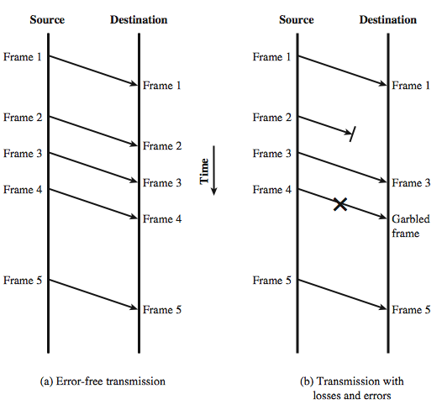
Model of Frame Transmission
Vertical time sequence diagram

Slide 11
Stop and Wait Flow control
source transmits frame
destination receives frame and replies with acknowledgement (ACK)
source waits for ACK before sending next frame
destination can stop flow by not sending ACK
works well for a few large frames
Stop and wait becomes inadequate if large block of data is split into small frames

Slide 12
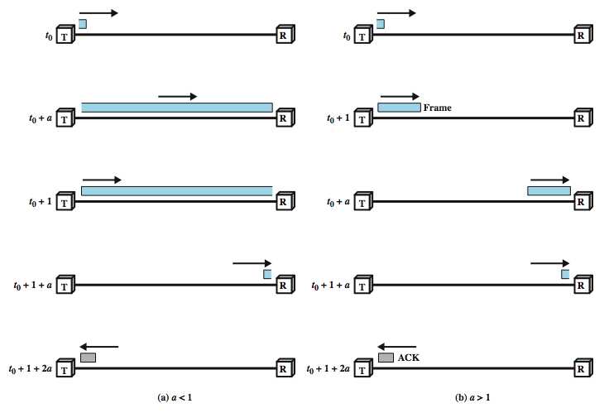
Stop and Wait Link Utilization

Slide 13
Continued…
B = R . (d/V)
B: length of the link in bits
R: data rate of the link, in bps
d: length or distance of the link in meters
V: velocity of propagation, in m/s
a = B/L
a: the propagation delay (with frame transmission time = 1)
L: the number of bits in the frame
or

Slide 14
Sliding Window Flow Control
allows multiple numbered frames to be in transit
receiver has buffer space of W frames long
transmitter sends up to W frames without ACK
ACK includes number of next frame expected
sequence number is bounded by size of field (k)
frames are numbered modulo 2^{k}
giving max window size of up to 2^{k} – 1
receiver can acknowledge frames without permitting further transmission (Receive Not Ready)
must send a normal acknowledge to resume
if we have full-duplex link, can piggyback ACKs

Slide 15
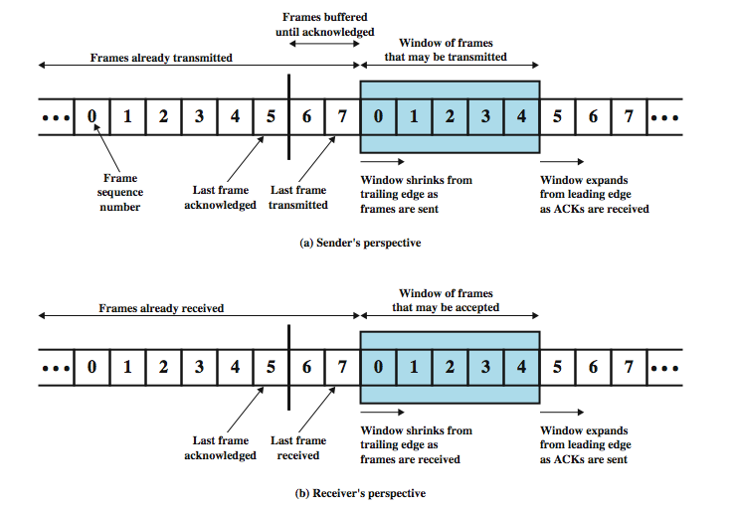
Sliding Window Diagram

Slide 16
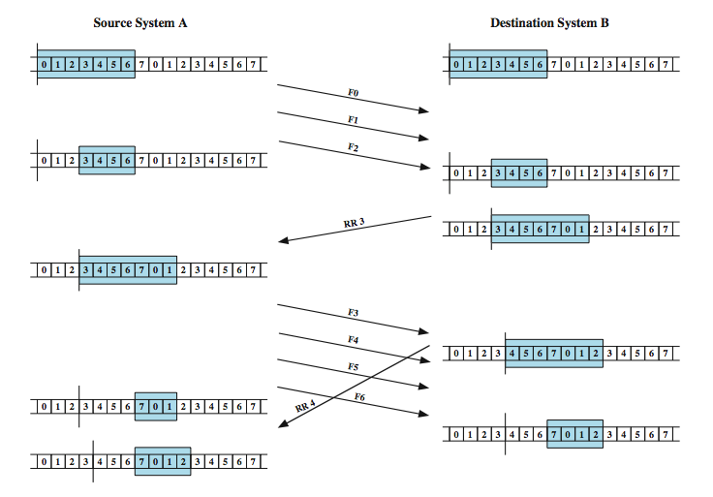
Sliding Window Example

Slide 17
Error Control
detection and correction of errors such as:
lost frames
damaged frames
common techniques for error control:
error detection
positive acknowledgment
retransmission after timeout
negative acknowledgement & retransmission

Slide 18
Automatic Repeat Request (ARQ)
The effect of ARQ is to turn an unreliable data link into a reliable one. Three versions of ARQ are:
stop and wait ARQ
Go-back-N ARQ
Selective-reject ARQ (selective retransmission)

Slide 19
Stop and Wait ARQ
source transmits single frame
wait for ACK
2 types of error occurs:
if received frame damaged, discard it
transmitter has timeout
if no ACK within timeout, retransmit. Source maintains a transmitted frame copy until ACK is received.
if ACK damaged, Transmitter will not recognize it
transmitter will retransmit
receive gets two copies of frame
use alternate numbering and ACK0 / ACK1

Slide 20
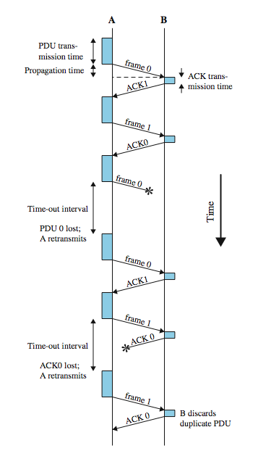
Stop and Wait ARQ
Advantage:
Simple

Slide 21
Go-Back-N ARQ
based on sliding window
if no error, ACK as usual
if error, reply with rejection(REJ)
discard that frame and all future frames until error frame received correctly.
transmitter must go back and retransmit that frame and all subsequent frames

Slide 22
Go-Back-N - Handling
Damaged Frame
error in frame i so receiver rejects frame i .
transmitter retransmits frames from i
Lost Frame
frame i lost and either
transmitter sends i+1 and receiver gets frame i+1 out of seq and rejects frame i (REJ i)
or transmitter times out and send ACK with P bit set which receiver responds to with ACK i
transmitter then retransmits frames from i

Slide 23
Go Back N - Handling
Damaged Acknowledgement
receiver gets frame i, sends ack (i+1) which is lost
Ack’s are cumulative, so next ACK (i+n) may arrive before transmitter times out on frame i
if transmitter times out, it sends ack with P bit set
can be repeated a number of times before a reset procedure is initiated
Damaged Rejection
reject for damaged frame is lost
handled as for lost frame when transmitter times out

Slide 24
Selective-Reject(ARQ)
only rejected frames are retransmitted
subsequent frames are accepted by the receiver and buffered
minimizes retransmission
receiver must maintain large enough buffer
more complex logic in transmitter
hence less widely used
useful for satellite links with long propagation delays

Slide 25
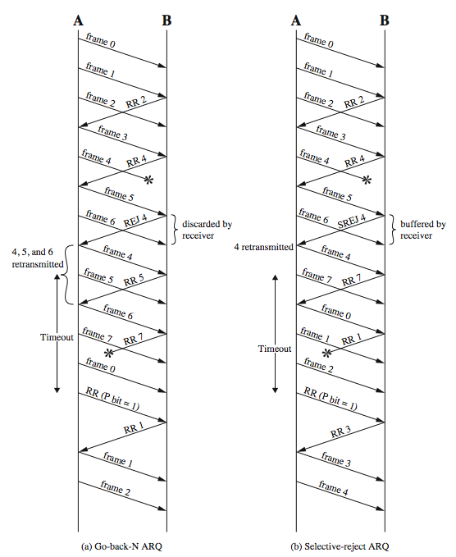
Go-Back-N vs Selective-Reject

Slide 26
Selective-reject ARQ
Window-size limitation
E.g. 3 bit sequence number, window size = 7
Station A sends frames 0 ~ 6 to station B
Station B receives all seven frames and cumulatively acknowledges with RR7
If RR 7 is lost
A times out and retransmit frame 0

Slide 27
Selective-reject ARQ (cont)
B has already advanced its receive window to accept frames 7, 0, 1, 2, 3, 4, and 5. Thus, it assumes that frame 7 has been lost and that this is a new frame 0 which it accepts.
0 1 2 3 4 5 6 7 0 1 2 3 4 5 ...
S
RR7 lost
retx
√
R

Slide 28
Selective-reject ARQ
Problem with the foregoing scenario
overlay between the sending and receiving windows
Solution
for a k-bit sequence number, the maximum window size is limited to 2^{k-1}.
0 1 2 3 4 5 6 7 0 1 2 ...
S
RR4 lost
retx
x
R

Slide 29

Stop and wait flow control performance issues

Slide 30

Error free sliding window flow control
Window size W, transmission time = 1, propagation time = a
Case 1: W >= 2a + 1
Sender A can transmit continuously with no pause and normalized throughput is 1.0
Case 2: W < 2a + 1
Sender A exhausts its window at t = W and cannot send additional frames until t = 2a + 1.
Normalized throughput is W / (2a+1)

Slide 31

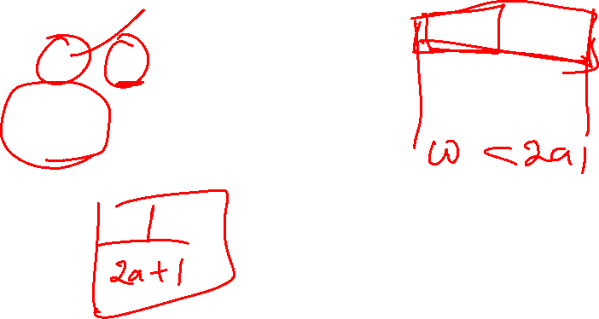

Slide 32
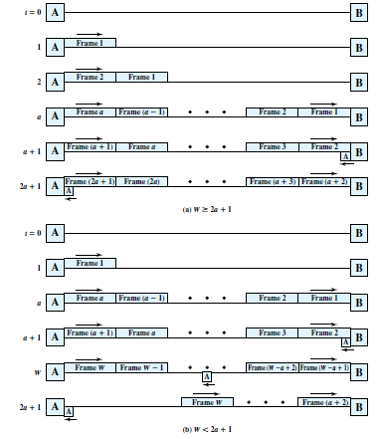

Slide 34
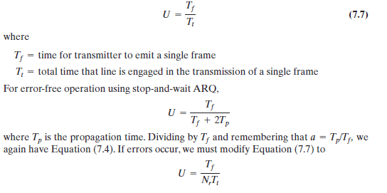
ARQ

Slide 35

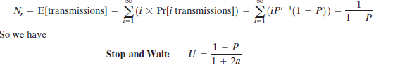

Slide 36

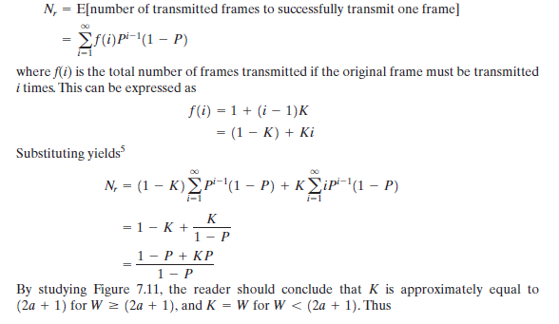

Slide 37
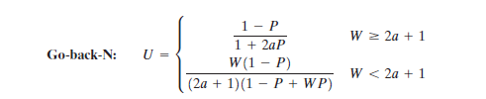

Slide 38
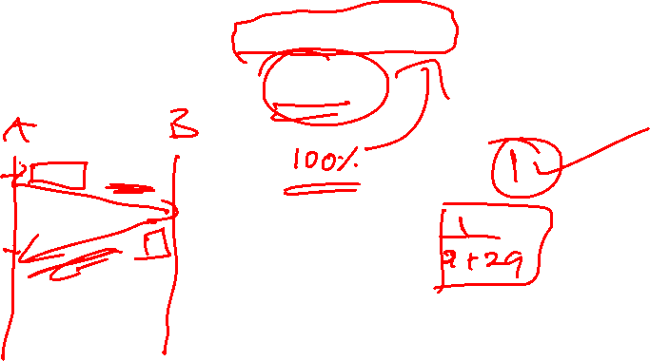
1. A channel has a data rate of 4 kbps and a propagation delay of 20ms. For what range of frame sizes does stop-and-wait give an efficiency of at least 50%?

Slide 39
Consider the use of 1000-bit frames on a 1-Mbps satellite channel with a 270-ms delay. What is the maximum link utilization for: a. Stop-and-wait flow control? b. Continuous flow control with a window size of 7? c. Continuous flow control with a window size of 127? d. Continuous flow control with a window size of 255?

Slide 40
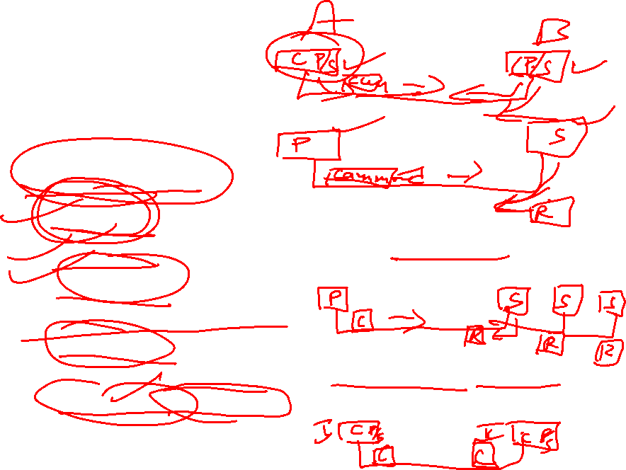
High Level Data Link Control (HDLC)
an important data link control protocol
Defines
3 station types:
Primary - controls operation of link
Secondary - under control of primary station
Combined - issues commands and responses
2 link configurations
Unbalanced - 1 primary, multiple secondary. Supports full duplex and half duplex transmission.
Balanced - 2 combined stations and supports full duplex and half duplex.

Slide 41
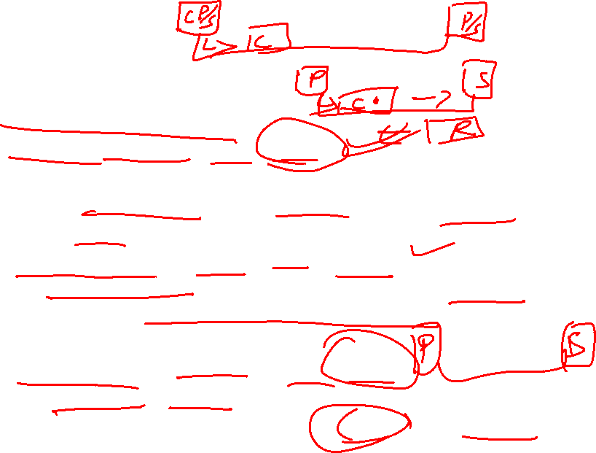
Cont…
3 data Transfer Modes
Normal Response Mode (NRM)
unbalanced configuration, primary initiates transfer
used on multi-drop lines, many terminals are connected to host computer.
Asynchronous Balanced Mode (ABM)
balanced configuration, either station initiates transmission without receiving permission from other combined station, has no polling overhead, widely used
Asynchronous Response Mode (ARM)
unbalanced configuration, secondary may initiate transmit without permission from primary, primary holds responsibility for the line, rarely used

Slide 42
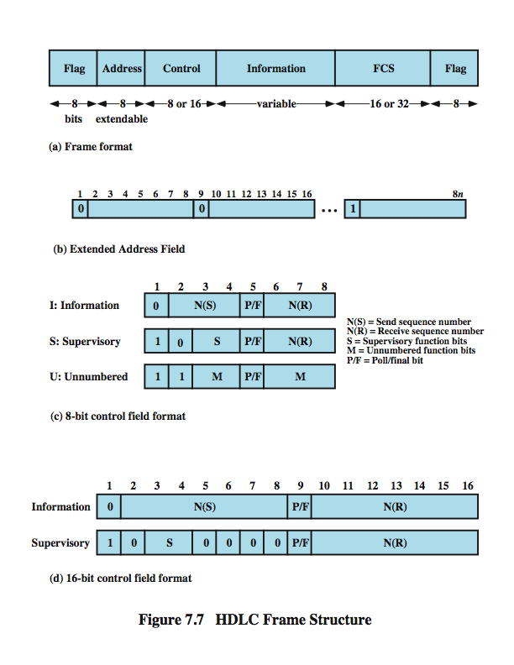

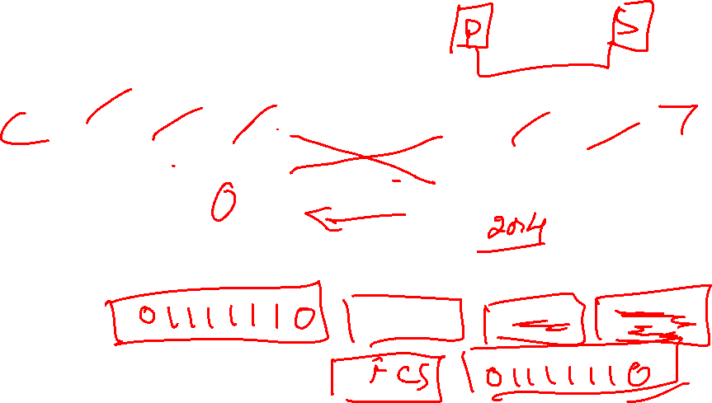
HDLC Frame Structure
synchronous transmission of frames
single frame format used
Header
Trailer

Slide 43
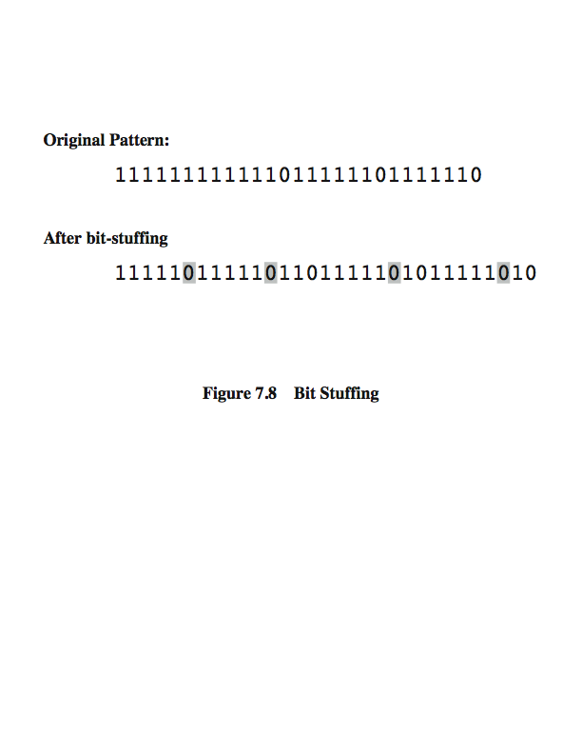
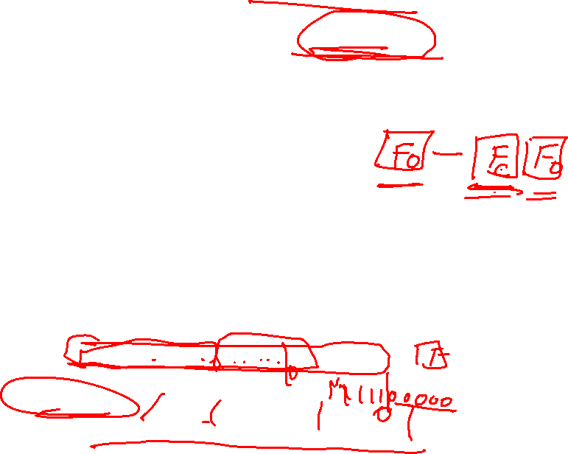
Flag Fields and Bit Stuffing
delimit frame at both ends with 01111110 seq
receiver hunts for flag sequence to synchronize
bit stuffing used to avoid confusion with data containing flag sequence 01111110
0 inserted after every sequence of five 1s
if receiver detects five 1s it checks next bit
if next bit is 0, it is deleted (was stuffed bit)
if next bit is 1 and seventh bit is 0, accept as flag
if sixth and seventh bits 1, sender is indicating abort

Slide 44
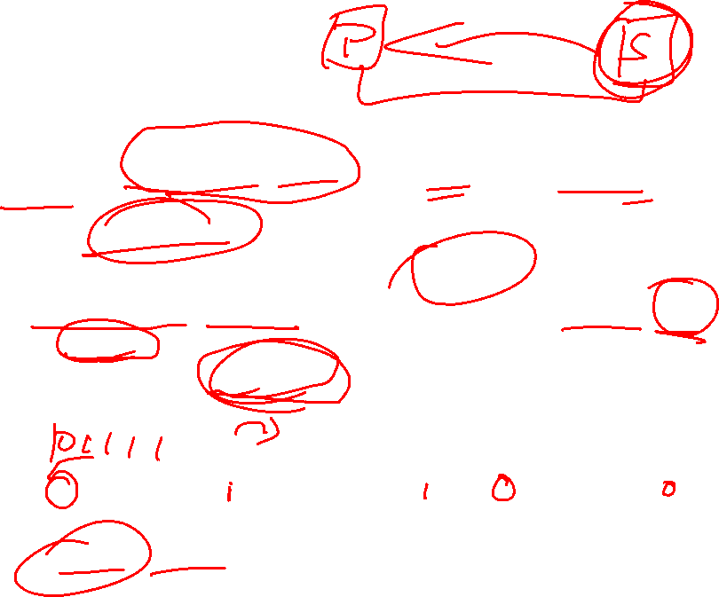
Address Field
identifies secondary station that sent or will receive frame
usually 8 bits long
may be extended to multiples of 7 bits
Left most bit of each octet indicates if it is the last octet (1) or not (0)
all ones address 11111111 is broadcast

Slide 45
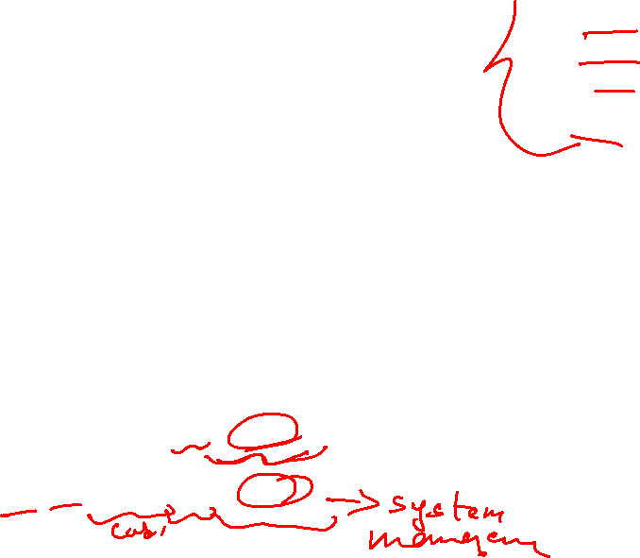
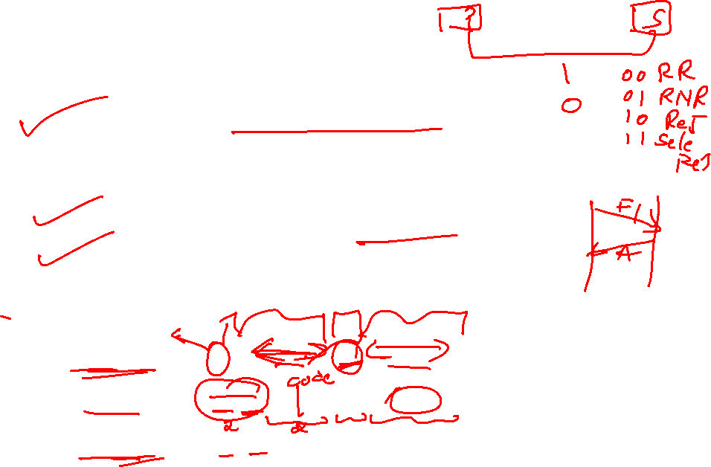
Control Field
different for different frame type
Information - data transmitted to user
Flow and error control piggybacked on information frames
Supervisory - ARQ when piggyback not used
Unnumbered - supplementary link control
first 1-2 bits of control field identify frame type

Slide 46
Control Field
use of Poll/Final bit depends on context
in command frame is P bit set to1 to solicit (poll) response from transmitter
in response frame is F bit set to 1 to indicate response to soliciting command
seq number usually 3 bits
can extend to 8 bits as shown below

Slide 47
Information & FCS Fields
Information Field
in information and some unnumbered frames
must contain integral number of octets
variable length
Frame Check Sequence Field (FCS)
used for error detection
either 16 bit CRC or 32 bit CRC

Slide 48
HDLC Operation
consists of exchange of information, supervisory and unnumbered frames
have three phases
initialization
by either side, set mode & seq
data transfer
with flow and error control
using both I & S-frames (RR, RNR, REJ, SREJ)
disconnect
when requested or fault noted

Slide 49
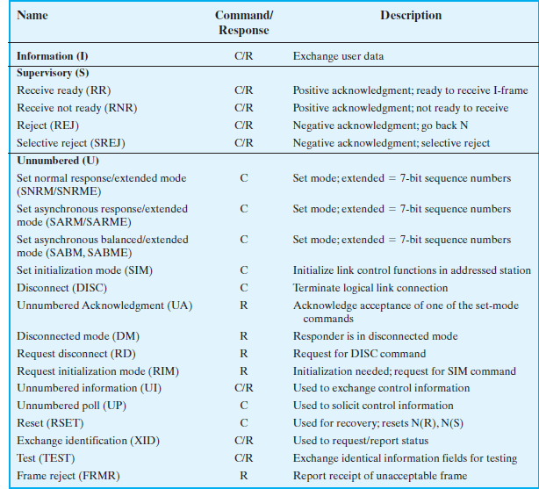

Slide 50
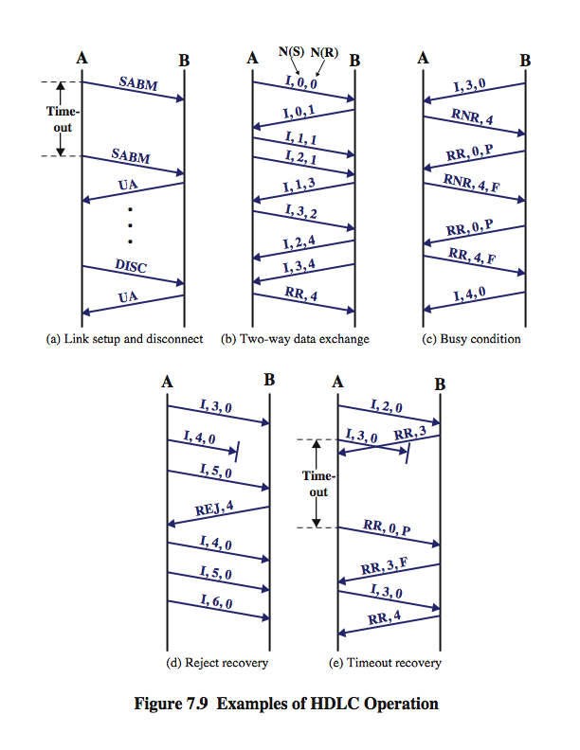
HDLC Operation Example

Slide 51
HDLC Operation Example

